Slide 1
Security systems solutions
A single board computer based approach
Lagani • Micera • Miliani

Slide 2
Smart security cameras
Requirements:
Interfaces and connectivity
Cost
Performance
Video processing and compression

Slide 3
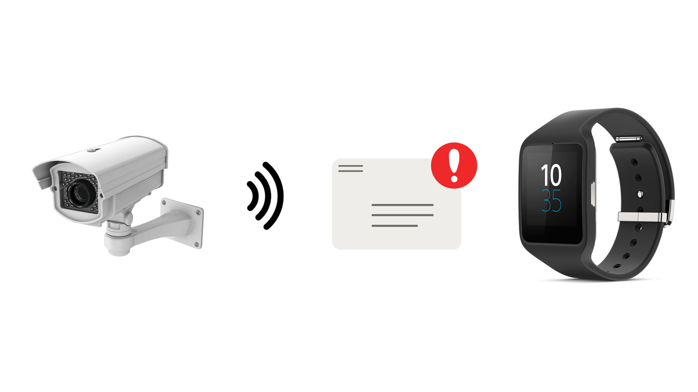
Wearable devices for security staff
Requirements:
Size
Wireless connectivity
Low power consumption

Slide 4
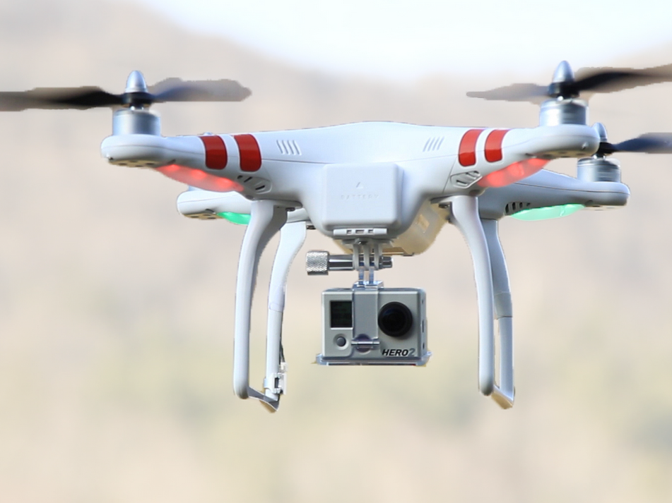
Security drones
Requirements:
Weight
Performance
Wireless connectivity
Low power consumption

Slide 5
Comparison metrics
Security cameras | Wearable devices for security staff | Drones
Interfaces and connectivity Cost Performance Video processing and compression | Size Wireless connectivity Low power consumption | Weight Performance Wireless connectivity Low power consumption

Slide 6
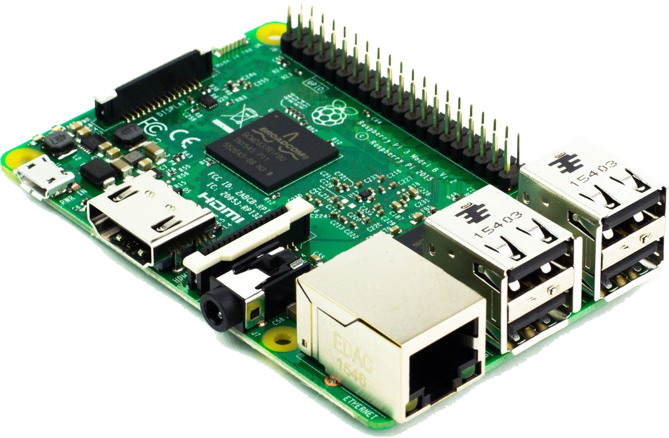
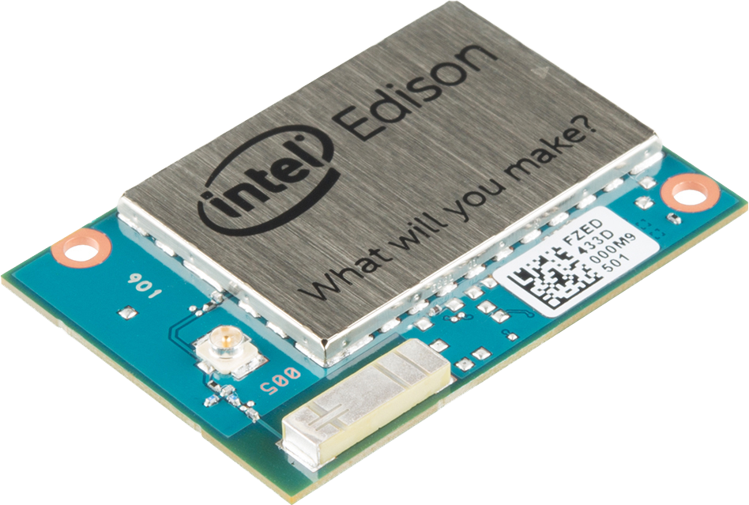
Possible choices
Raspberry Pi 3 Model B
Intel Edison

Slide 7
Outline
Performance evaluation
Raspberry applications
Intel Edison applications
Conclusions

Slide 8
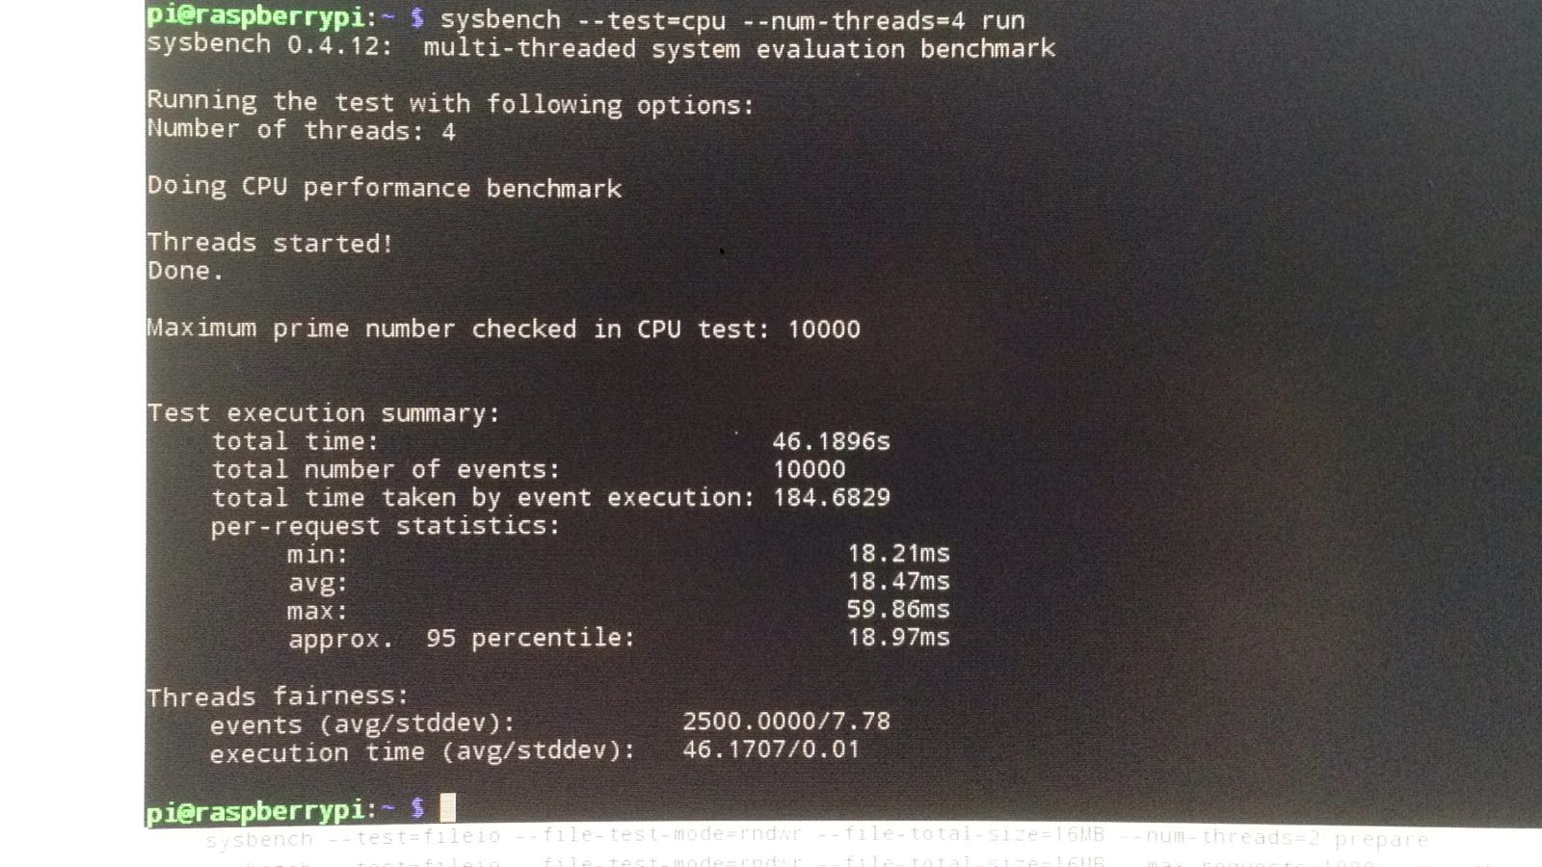
Performance evaluation: Sysbench

Slide 9
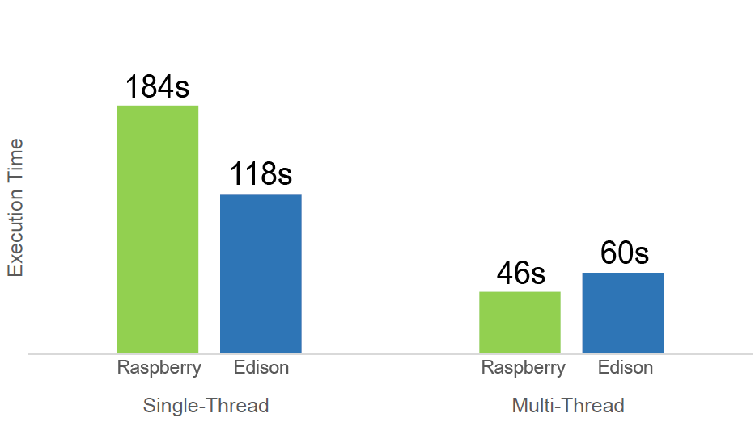
Performance evaluation: CPU test
sysbench on finding prime numbers
Actual command: sysbench --test=cpu --num-thread=<#threads> run
Hunt, D. (2014). Raspberry Pi, Beaglebone Black, Intel Edison – Benchmarked.
Available at http://www.davidhunt.ie/raspberry-pi-beaglebone-black-intel-edison-benchmarked/ Accessed March 15 2017

Slide 10
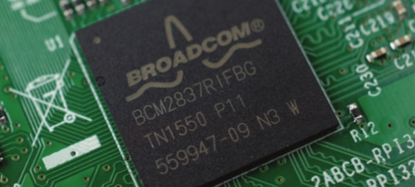
Raspberry components: Broadcom BCM2837 SoC
CPU + GPU SoC
CPU: ARM Cortex-A53, 64bit, quad-core, 1.2GHz, 40nm process
GPU: Broadcom VideoCore IV, 400MHz
RAM: 1GB LPDDR2, 900MHz

Slide 11
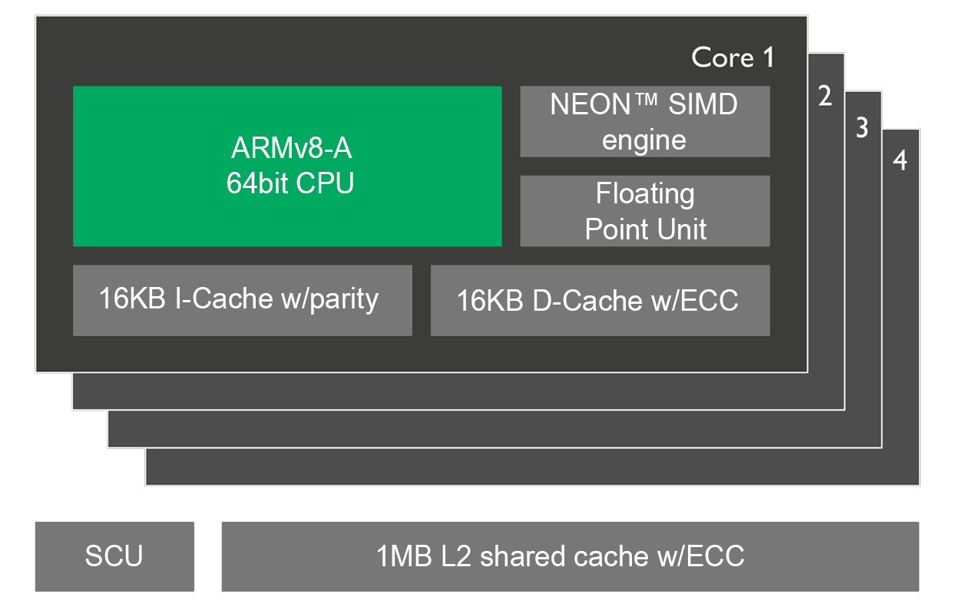
Raspberry components: ARM Cortex-A53

Slide 12
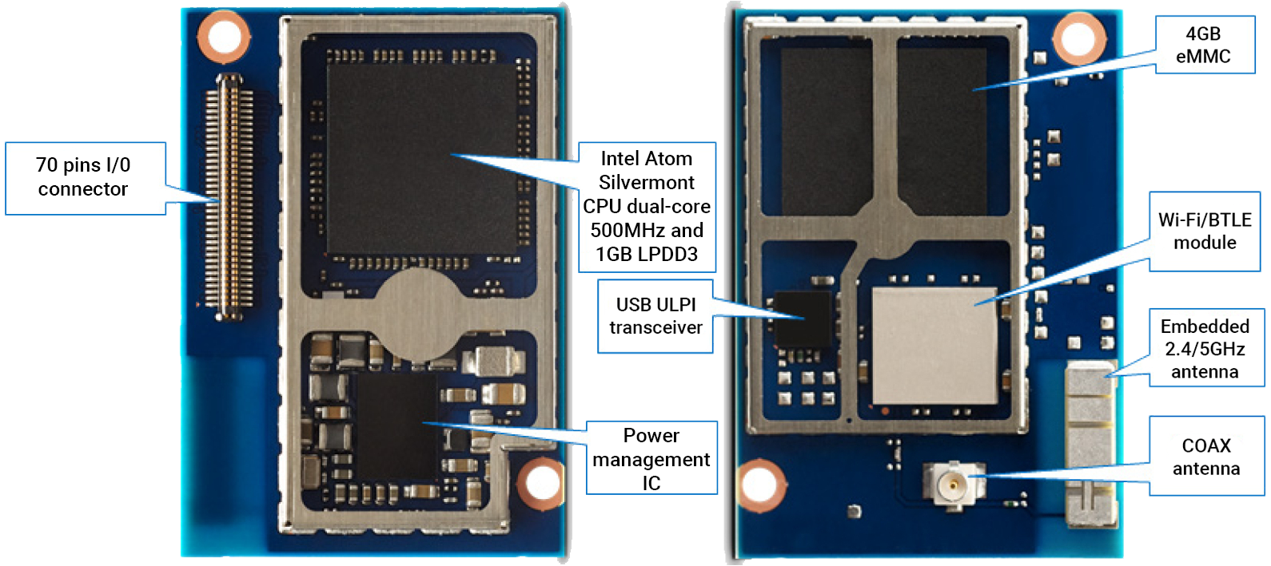
Intel Edison components: main module

Slide 13
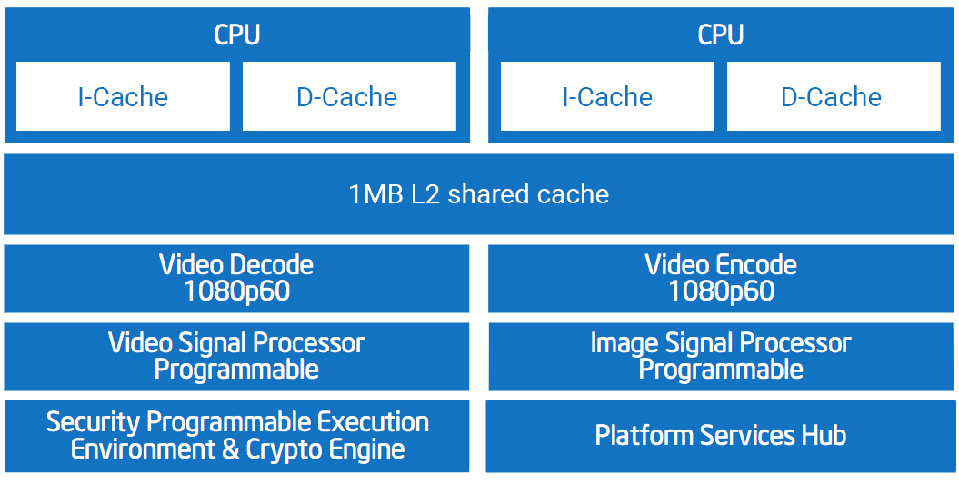
Intel Edison components: Intel Atom CPU

Slide 14
Performance evaluation: CPU test
sysbench on finding prime numbers
Intel Edison:
More cache (1MB vs 0.5MB)
More advanced RAM technology (LPDDR3 vs LPDDR2)
Raspberry:
More cores (4 vs 2)
Actual command: sysbench --test=cpu --num-thread=<#threads> run
Hunt, D. (2014). Raspberry Pi, Beaglebone Black, Intel Edison – Benchmarked.
Available at http://www.davidhunt.ie/raspberry-pi-beaglebone-black-intel-edison-benchmarked/ Accessed March 15 2017

Slide 15
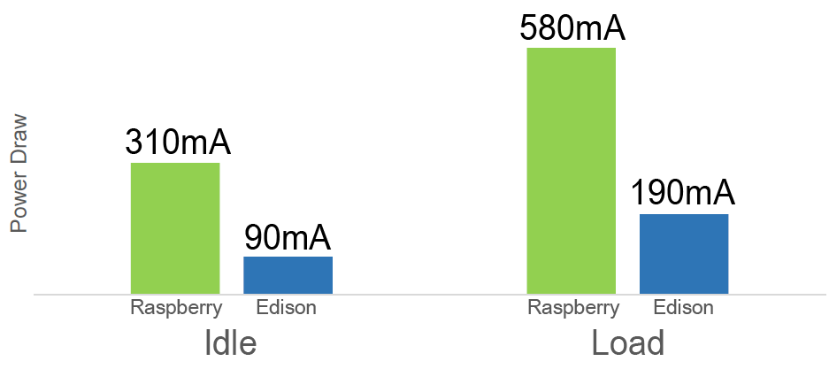
Performance evaluation: power consumption
Intel Edison:
Only 2 cores, 500MHz
Few interfaces
22nm process
Raspberry:
4 cores, 1.2GHz
Many interfaces
40nm process
[1] MagPi, (2016). Raspberry pi 3 is out now! specs, benchmarks & more, The MagPi Magazine,
Available at https://www.raspberrypi.org/magpi/raspberry-pi-3-specs-benchmarks // Accessed March 15 2017
[2] Hirsh, M., (2016). Measured power consumption of Intel Edison, SciVision, Inc.,
Available at https://www.scivision.co/measured-power-consumption-of-intel-edison // Accessed March 15 2017

Slide 16
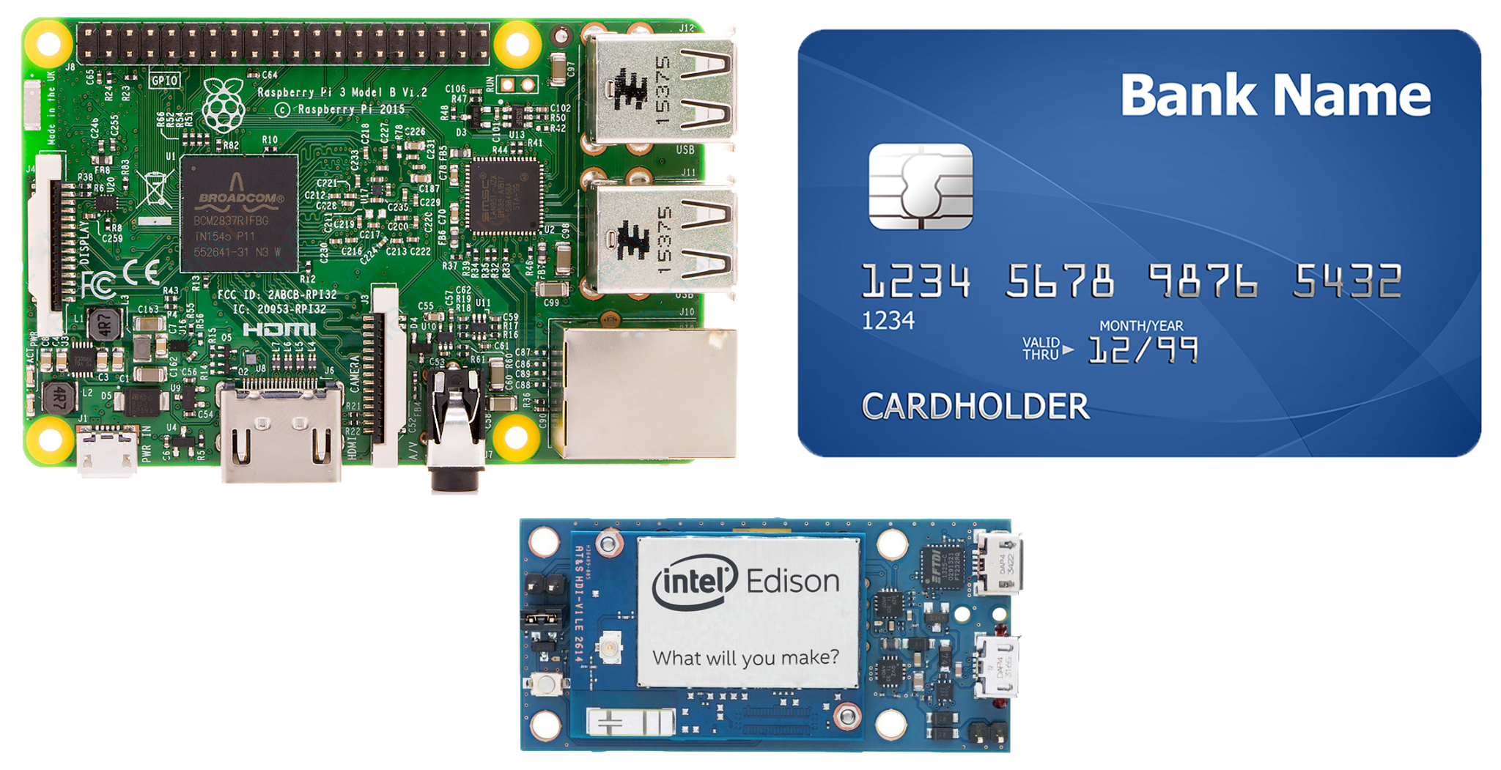
Boards size comparison

Slide 17
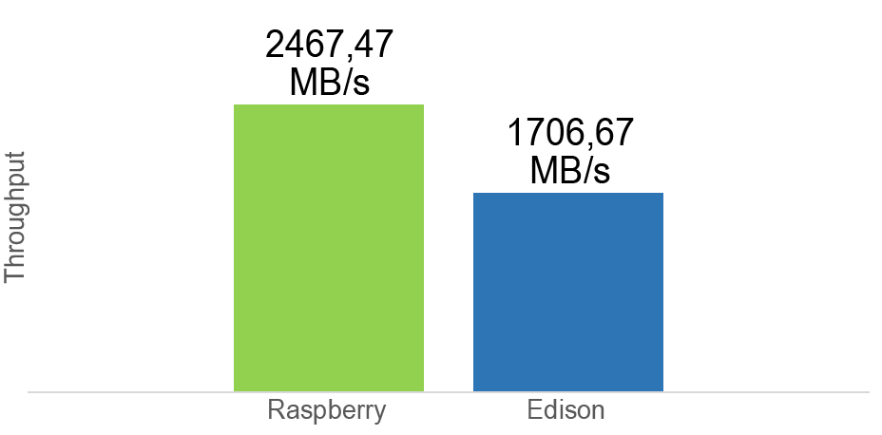
Performance evaluation: memory read/write test
sysbench on sequential memory reads and writes
Memory acces speed:
Raspberry: 1.2GHz processor, 900MHz RAM (RAM bottleneck).
Edison: 500MHz processor, 800MHz RAM (processor bottleneck).
Raspberry: More cores → More parallel accesses → Higher bus utilization
Actual command: sysbench --test=memory --memory-block-size=1M --memory-total-size=10G --num-thread=<#threads> run
Hunt, D. (2014). Raspberry Pi, Beaglebone Black, Intel Edison – Benchmarked.
Available at http://www.davidhunt.ie/raspberry-pi-beaglebone-black-intel-edison-benchmarked/ Accessed March 15 2017

Slide 18
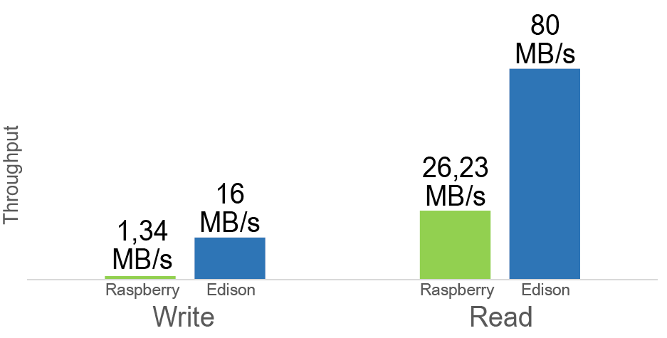
Performance evaluation: storage read/write test
sysbench on file random reads and writes
Memory access speed:
Raspberry: External microSD.
Edison: Integrated flash memory.
Actual command: sysbench --test=fileio --file-test-mode=rndwr --file-total-size=16MB --num-thread=<#threads> prepare && sysbench --test=fileio --file-test-mode=rndwr --file-total-size=16MB --max-requests=1000 --num-thread=<#threads> run
Hunt, D. (2014). Raspberry Pi, Beaglebone Black, Intel Edison – Benchmarked.
Available at http://www.davidhunt.ie/raspberry-pi-beaglebone-black-intel-edison-benchmarked/ Accessed March 15 2017

Slide 19
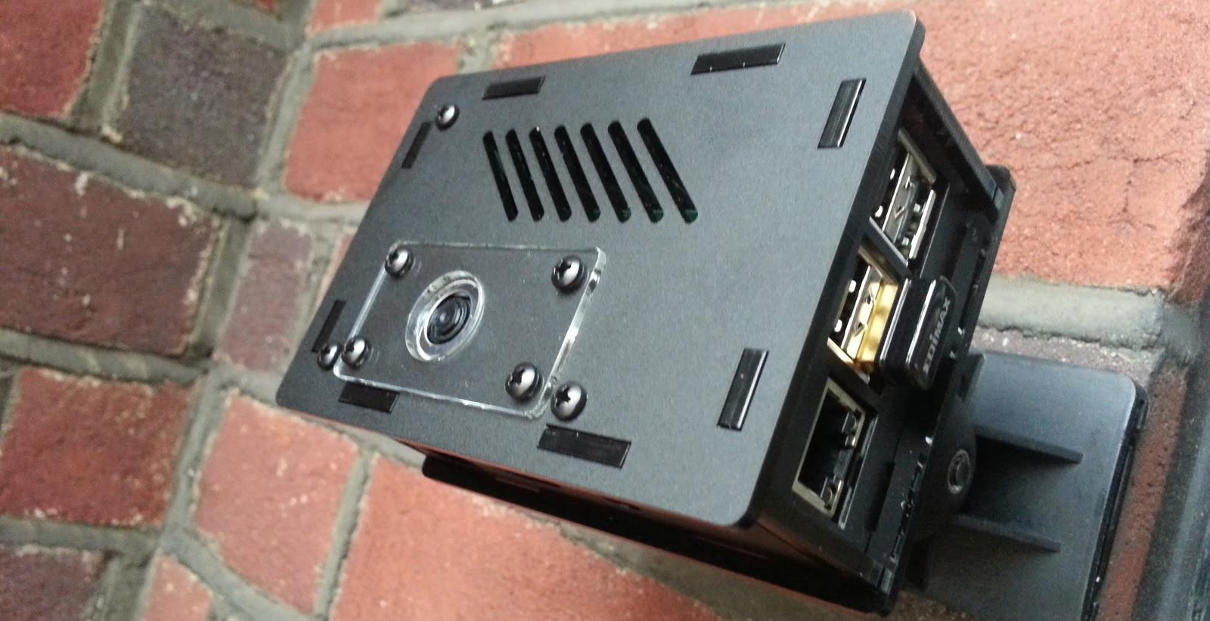
Raspberry applications: security cameras
Why Raspberry?
Performance
Low Cost (33$)
Many Interfaces

Slide 20
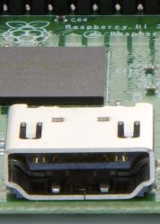
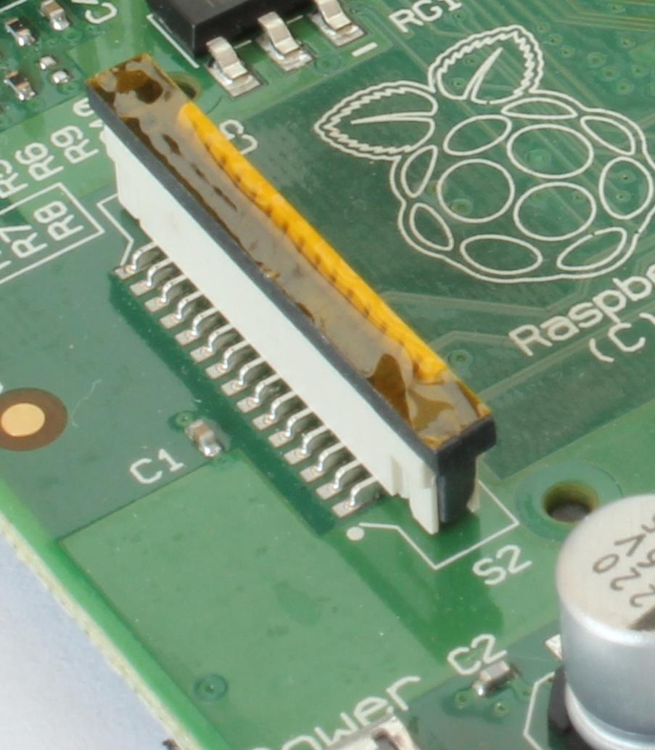
Raspberry components: connectivity and interfaces

Slide 21
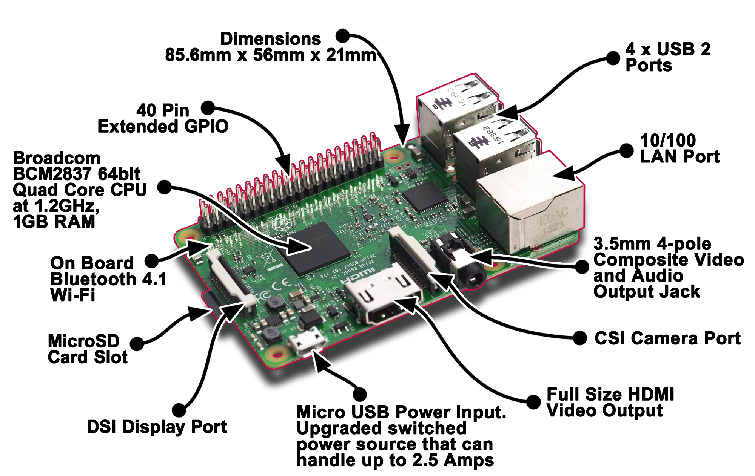
Raspberry: components

Slide 22
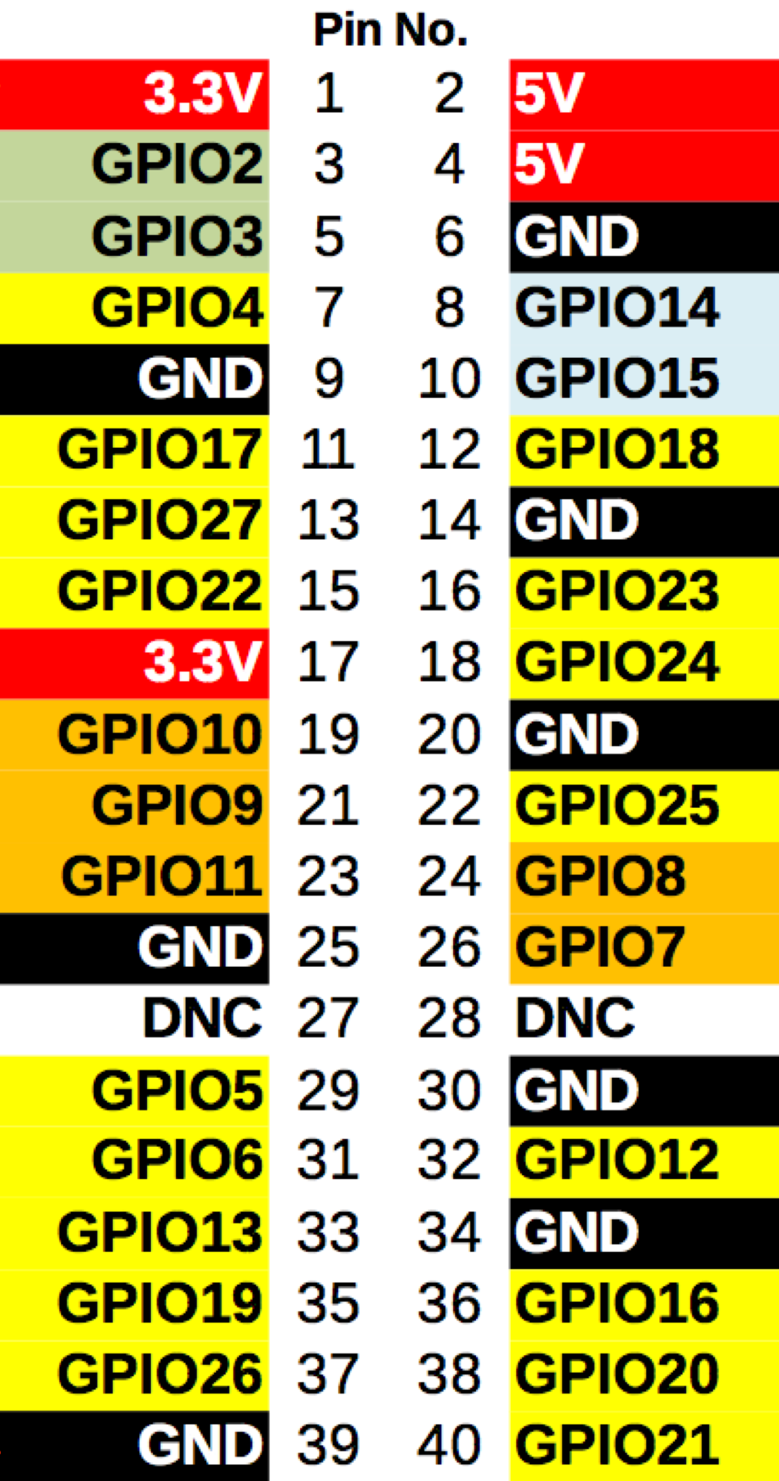
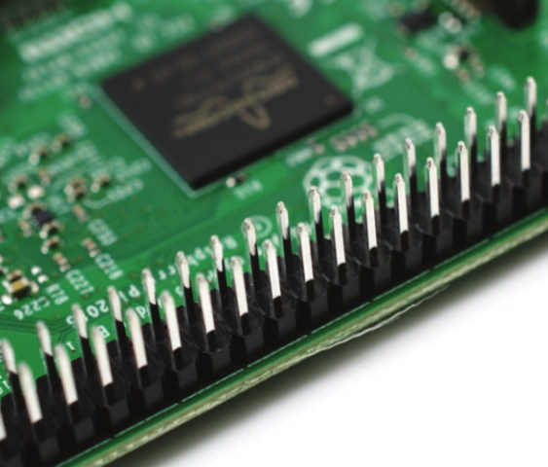
Raspberry components: GPIO

Slide 23
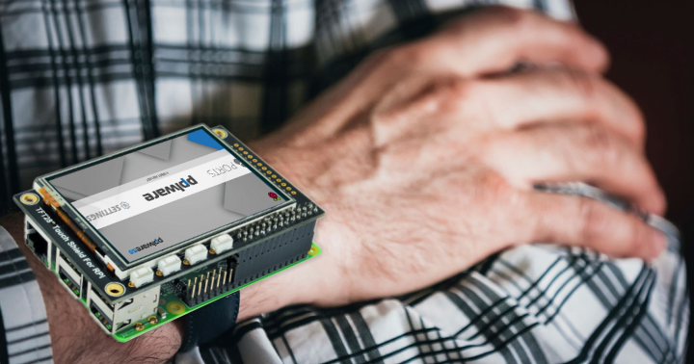
Raspberry for wearable devices: not a good idea
Problems:
Size (85.6 x 56 mm)
Weight (45g)
Power Consumption (4W)

Slide 24
Intel Edison
Pros:
Small size (25 x 35.5 mm)
Low weight (5.282 g)
Low power consumption (1W)
Target applications:
IoT
Wearable devices

Slide 25
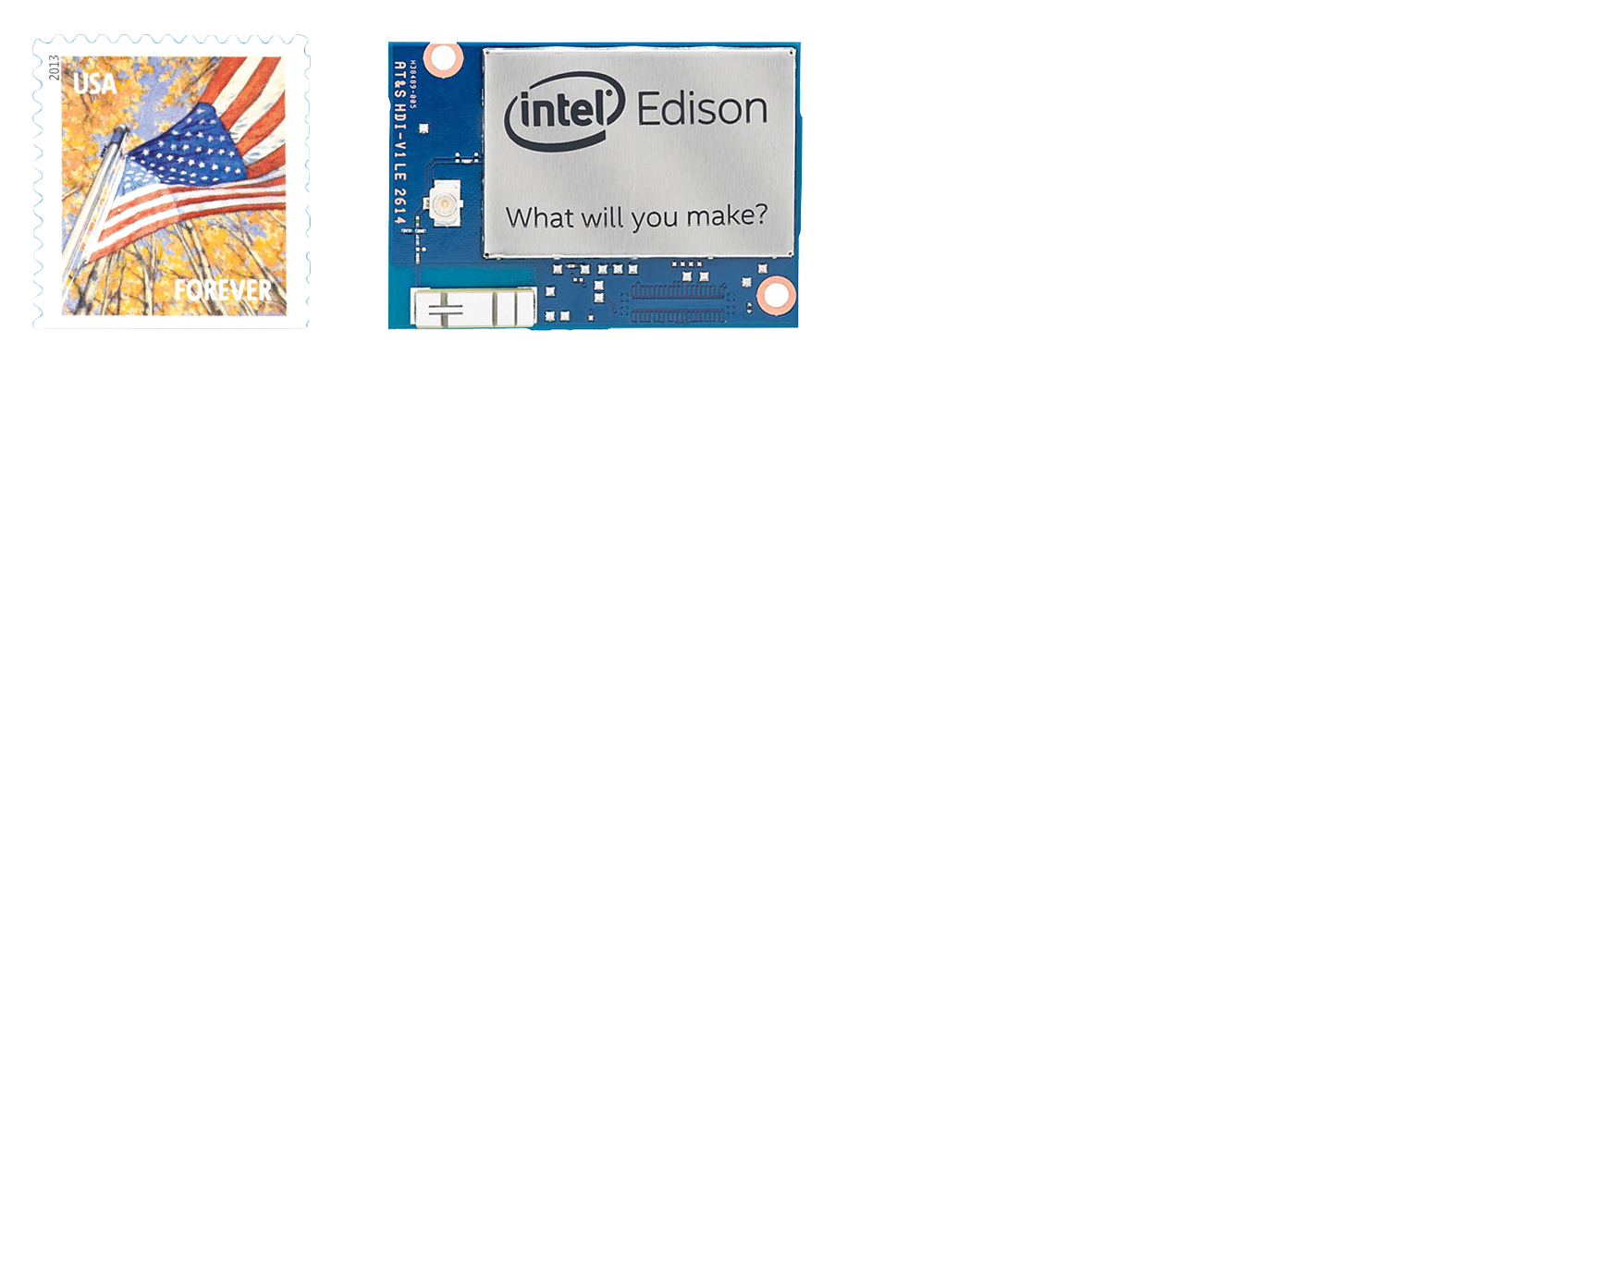
Intel Edison configurations: main module

Slide 26
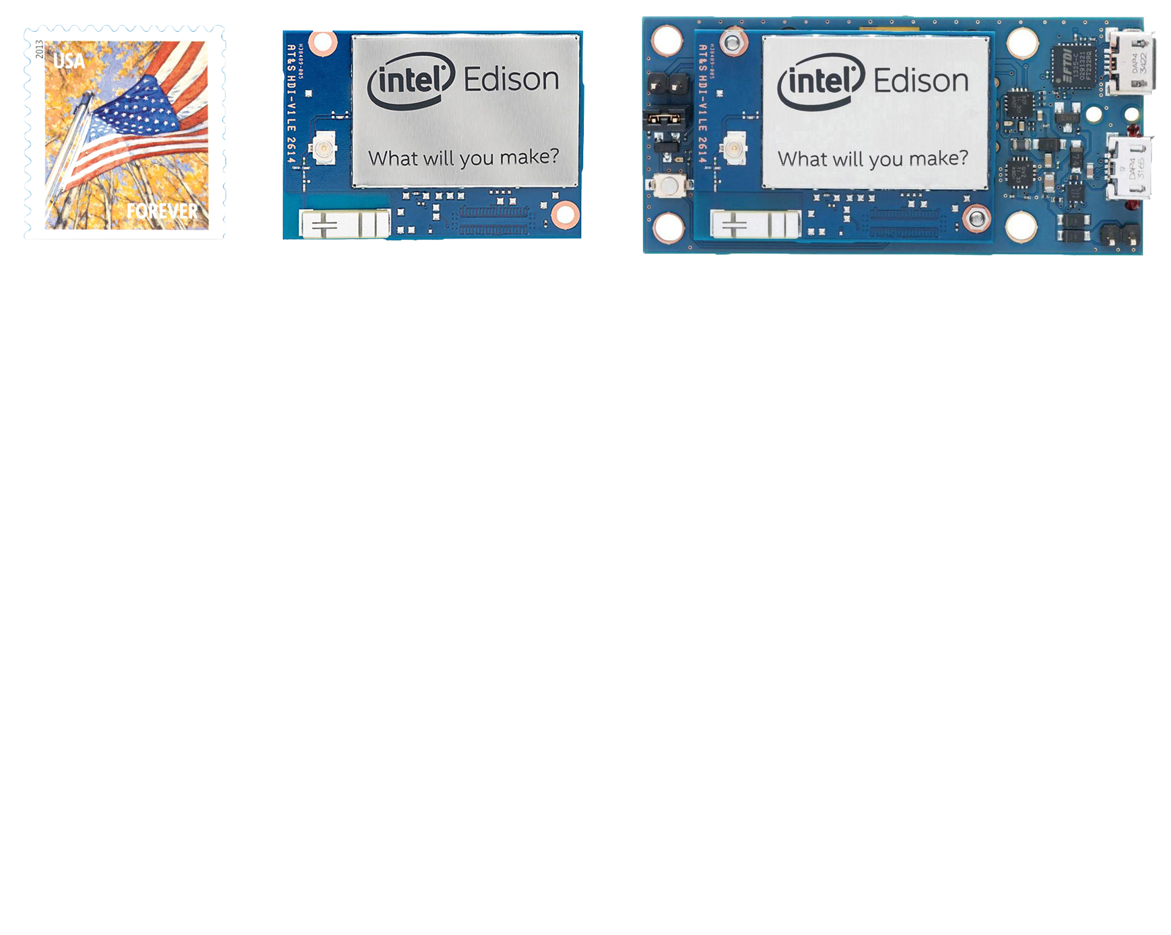
Intel Edison configurations: breakout board

Slide 27
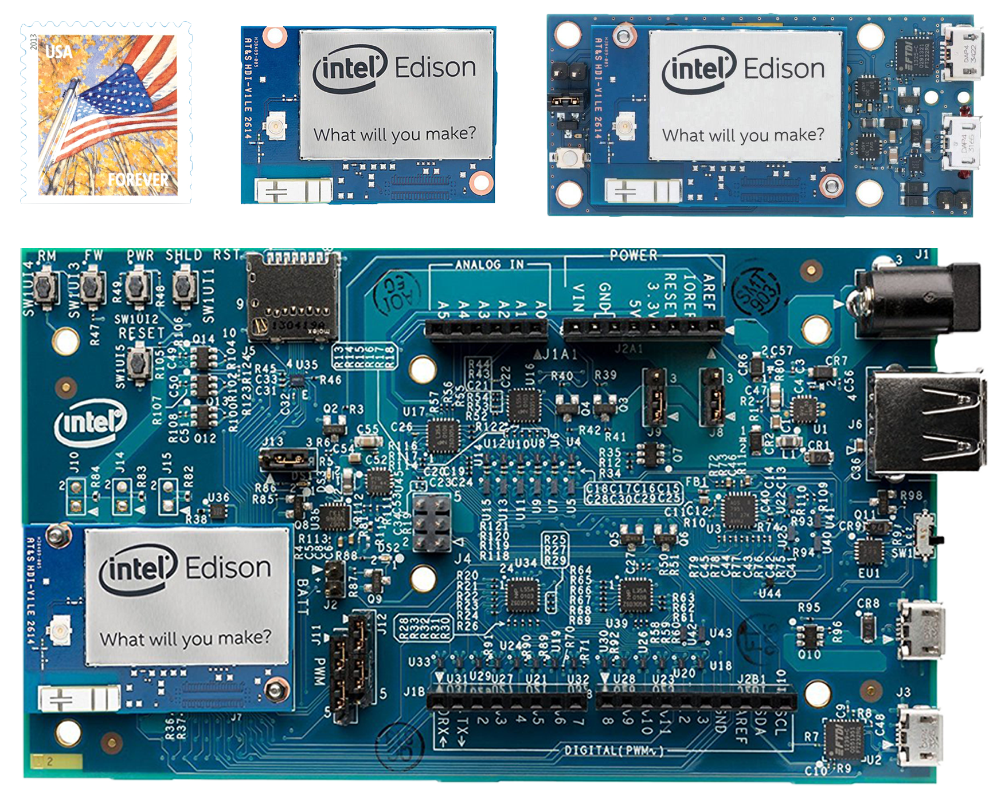
Intel Edison configurations: kit for Arduino

Slide 28
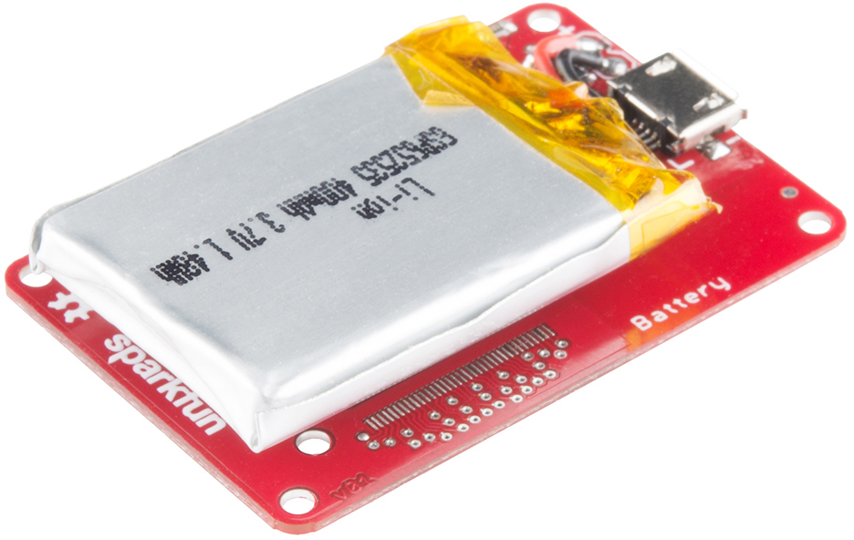
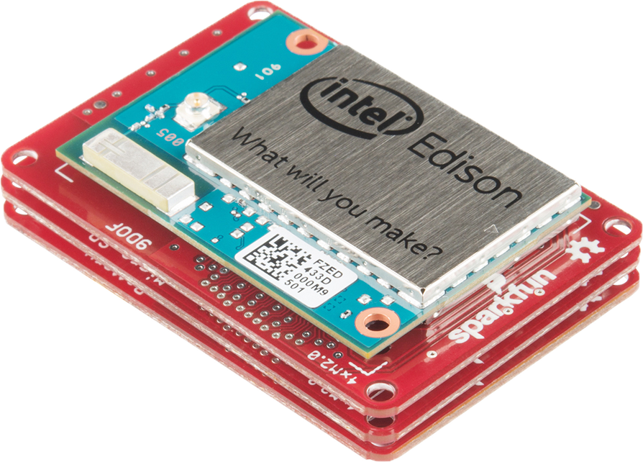
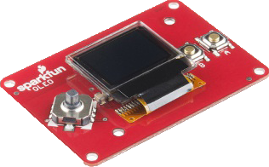
Intel Edison configurations: Sparkfun blocks

Slide 29
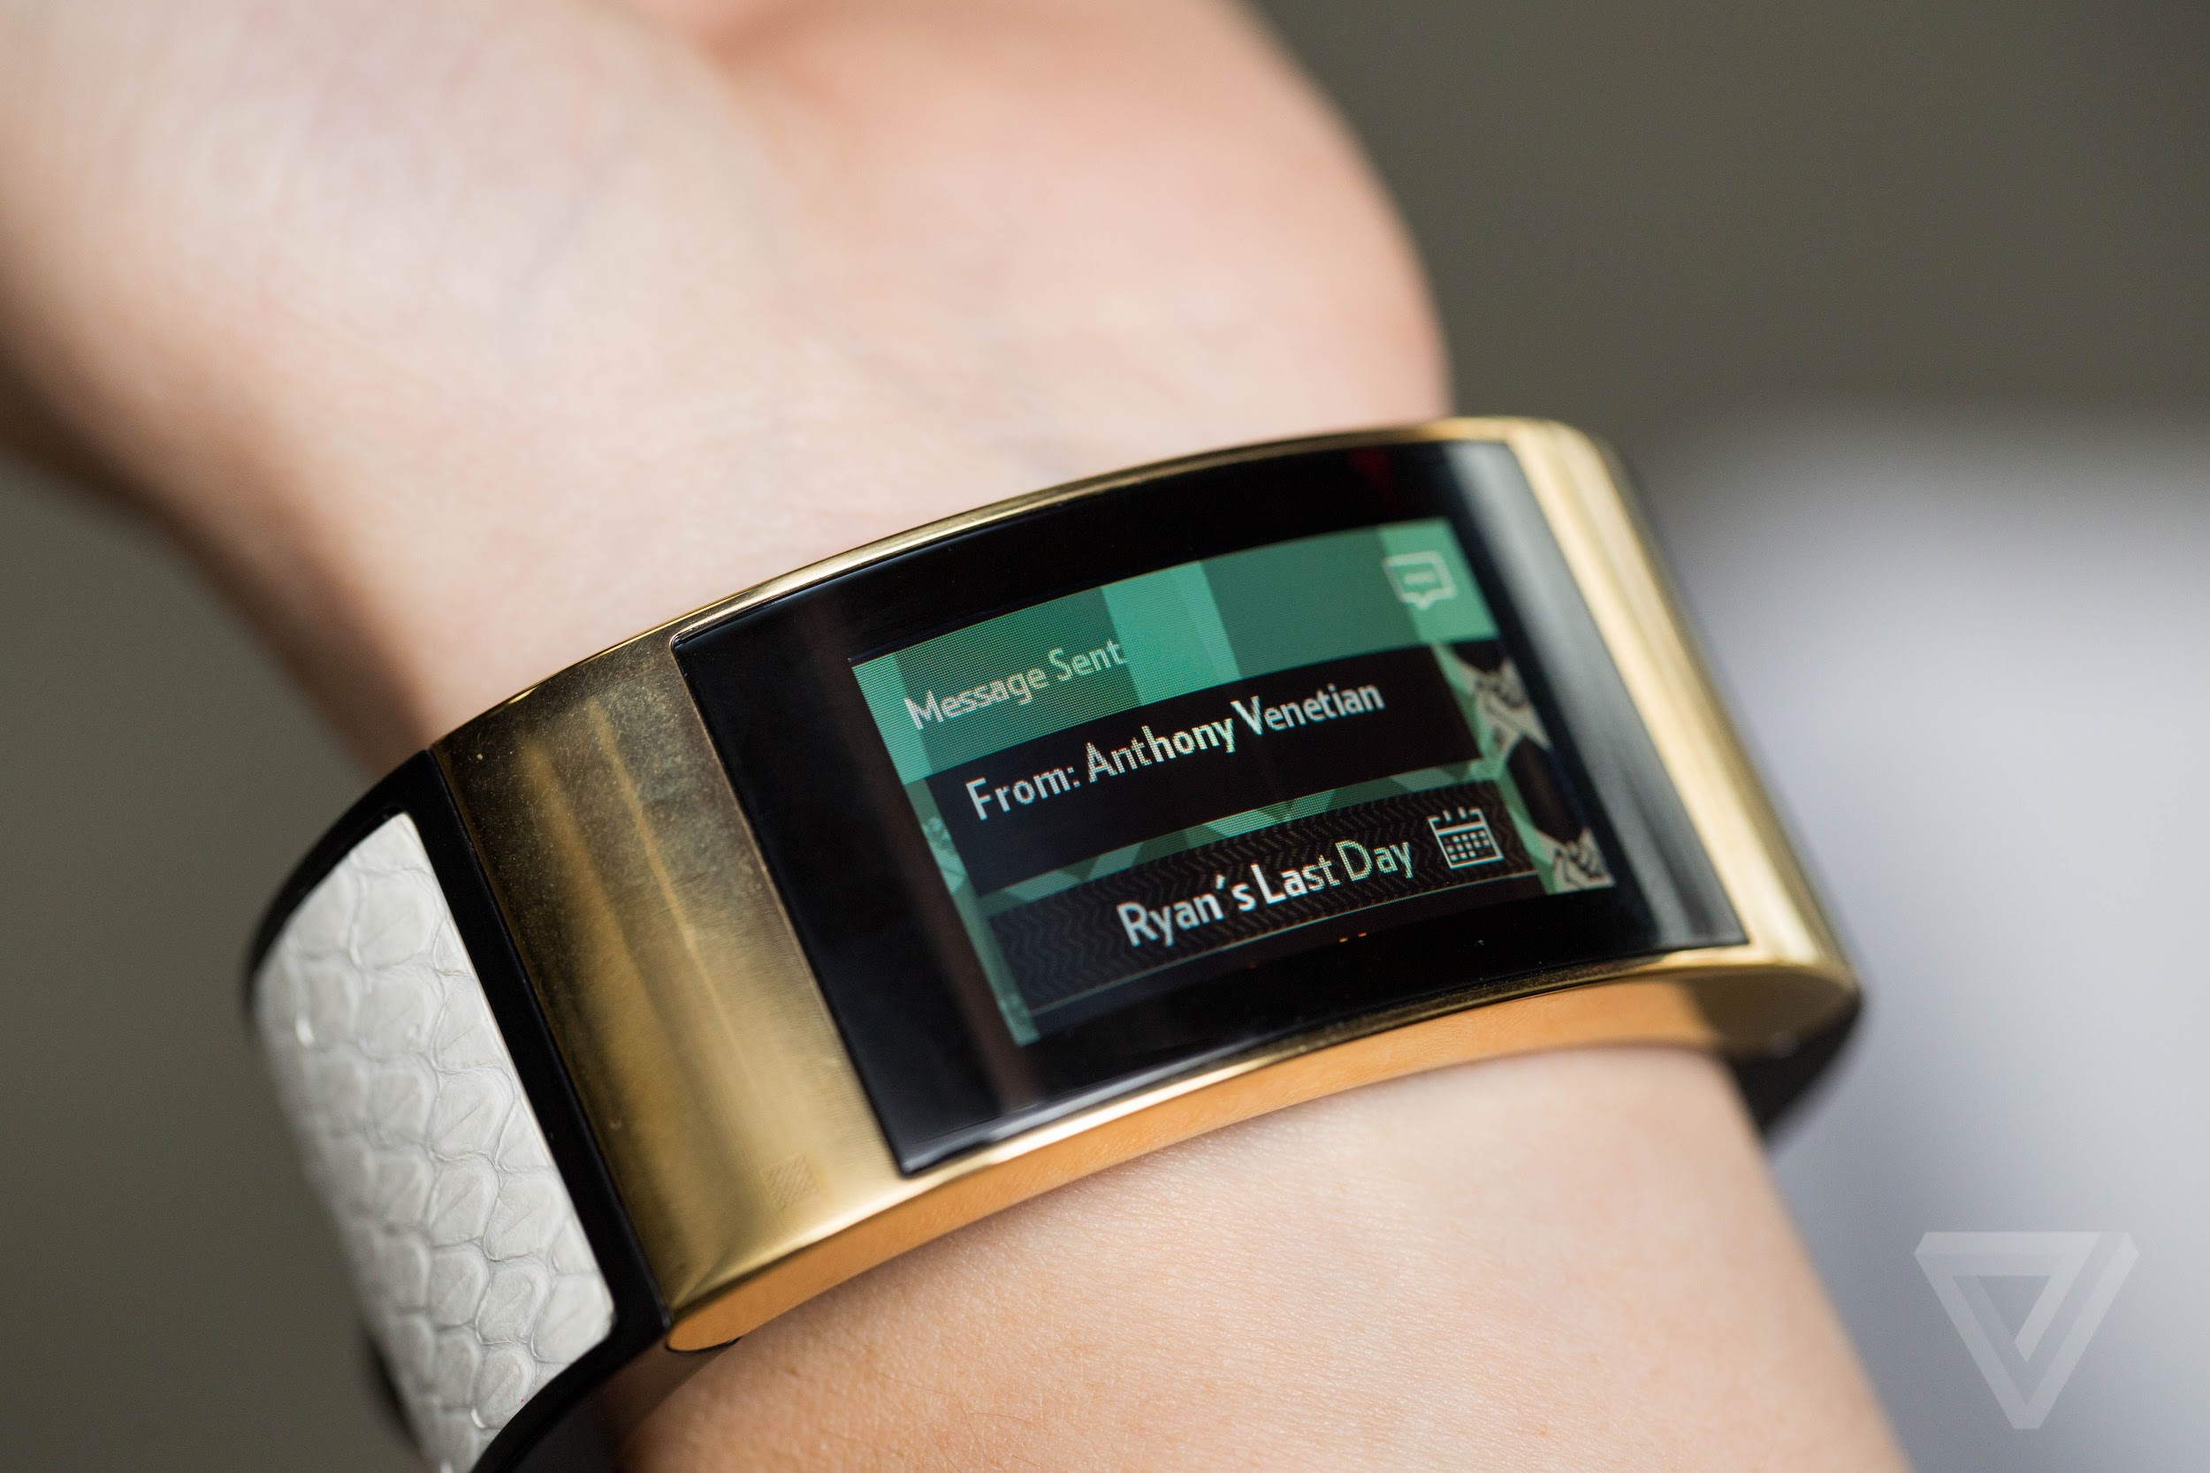
Intel Edison: possible applications

Slide 30
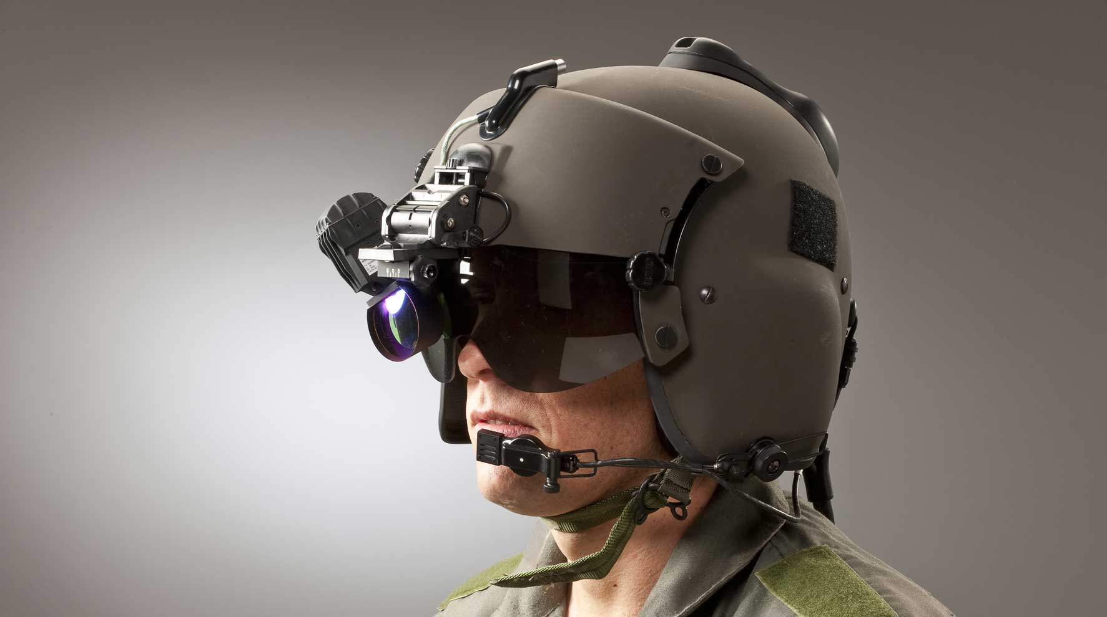
Intel Edison: possible applications

Slide 31
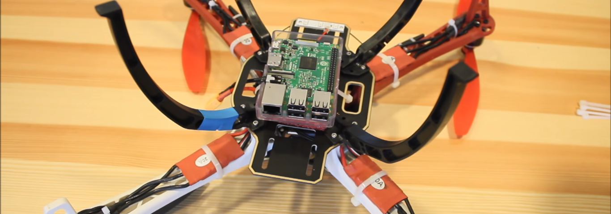
Raspberry applications: security drone
Why Raspberry?
 | Raspberry | Edison + Kit for Arduino
Weight | 45g | 128g
Price | 33$
75$ Arduino
+ 2 x 20$ Sparkfun Blocks
= 115$

Slide 32
Conclusions
 | Raspberry Pi 3 Model B | Intel Edison
Applications | Sensor Networks Robotics | Wearable device IoT
Why? | Lower price More performance More I/O Interfaces | Lower power consumption Smaller size

Slide 33
References
Raspberry Pi 3 Model B:
https://www.raspberrypi.org/products/raspberry-pi-3-model-b/
https://it.wikipedia.org/wiki/Raspberry_Pi#Raspberry_Pi_3
https://www.raspberrypi.org/magpi/raspberry-pi-3-specs-benchmarks/
http://uk.rs-online.com/web/p/processor-microcontroller-development-kits/8968660/
https://wiki.gentoo.org/wiki/Sysbench
https://www.arm.com/products/processors/technologies/neon.php
Intel Edison:
https://en.wikipedia.org/wiki/Intel_Edison
http://www.intel.com/content/dam/support/us/en/documents/edison/sb/edison-module_HG_331189.pdf
https://software.intel.com/en-us/articles/what-is-the-intel-edison-module
https://software.intel.com/en-us/articles/when-to-use-the-intel-edison-board
https://software.intel.com/en-us/iot/hardware/edison
http://www.intel.com/buy/us/en/product/emergingtechnologies/intel-edison-kit-462187
https://software.intel.com/en-us/get-started-edison-windows
https://www.sitepoint.com/introduction-intel-edison-iot-developers/
https://learn.sparkfun.com/tutorials/general-guide-to-sparkfun-blocks-for-intel-edison
https://www.arduino.cc/en/ArduinoCertified/IntelEdison#toc3
http://srlm.io/2015/03/02/intel-edison-benchmarks/
https://www.scivision.co/measured-power-consumption-of-intel-edison/
http://www.davidhunt.ie/creator-ci20-benchmarked/

Slide 34
Thanks for the attention

